Slide 1
Sunday, 22 July, 07:30-20:00
Room Elicium 1, RAI Amsterdam

Slide 2

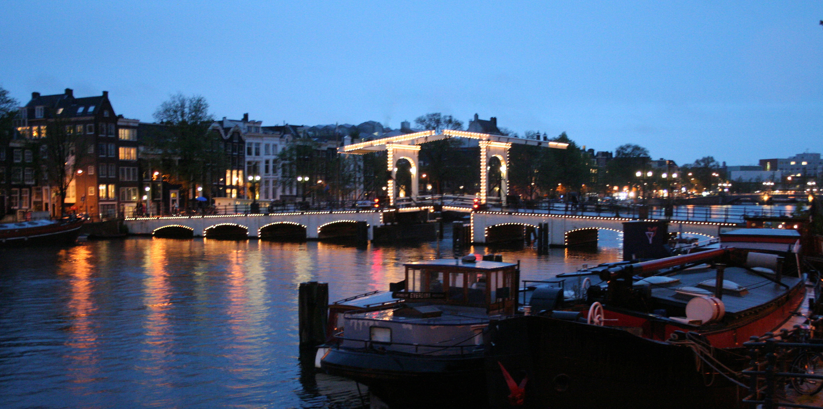

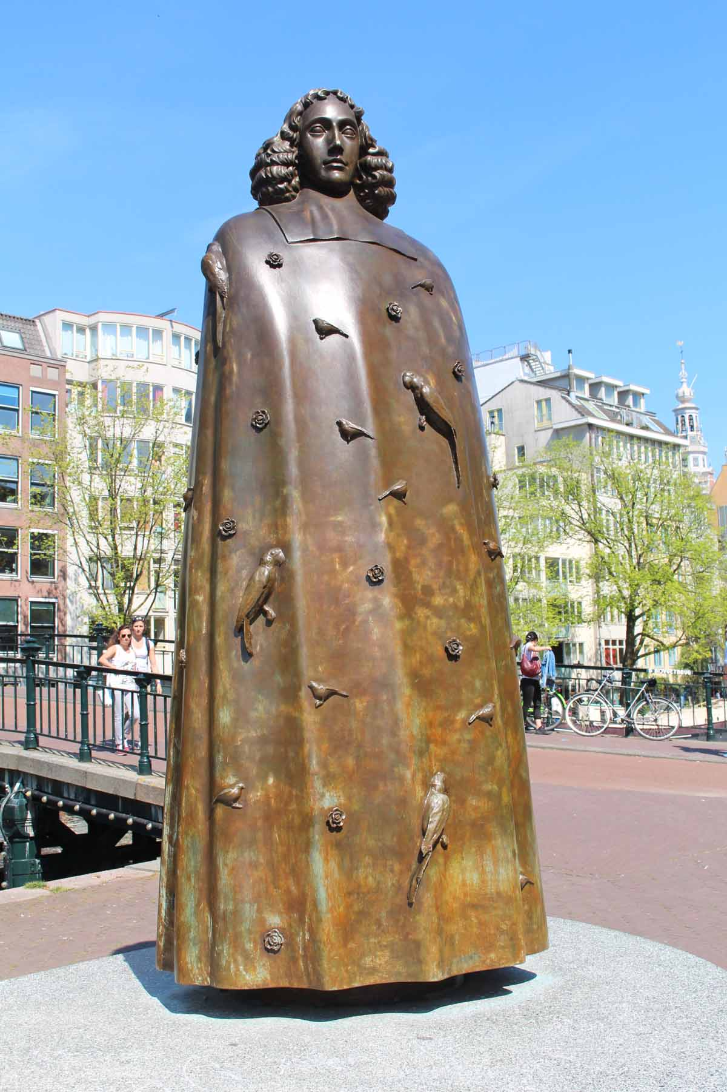

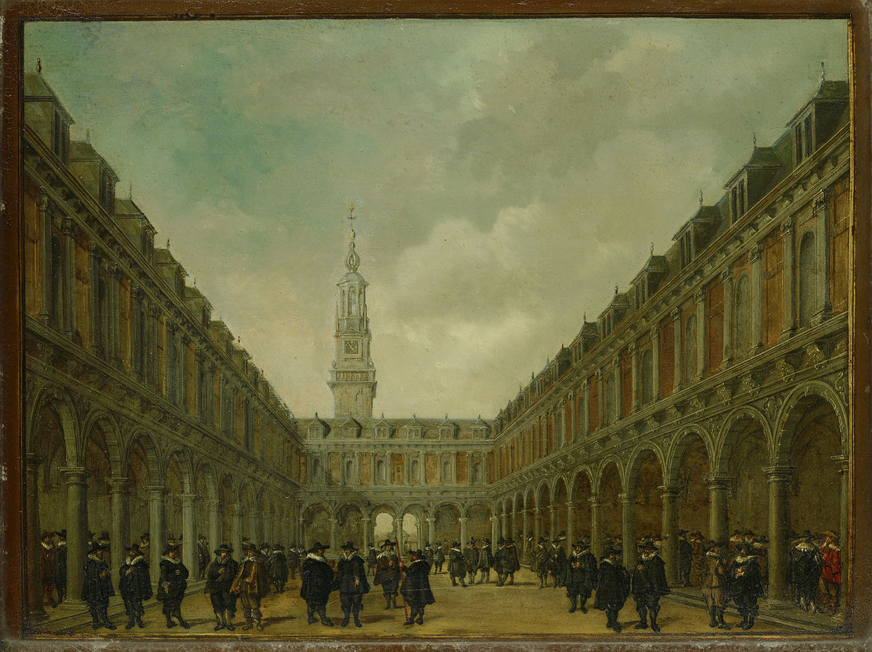

Welcome to Amsterdam

Slide 3




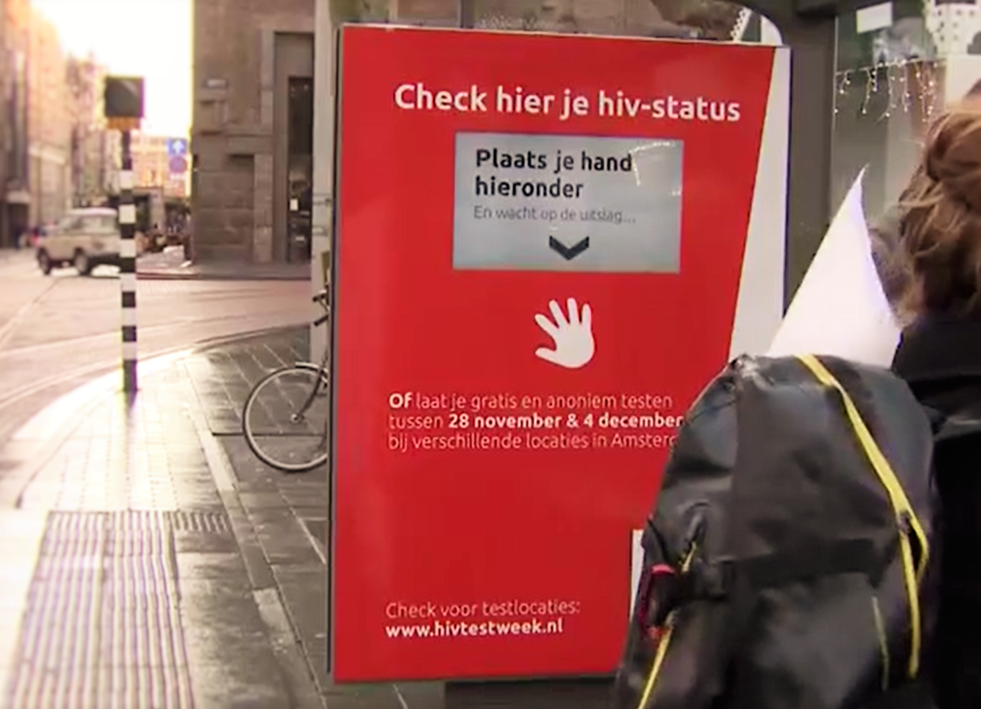
Welcome to Amsterdam

Slide 4

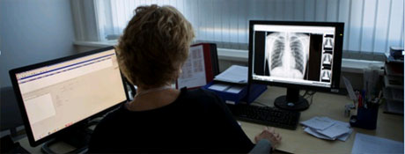
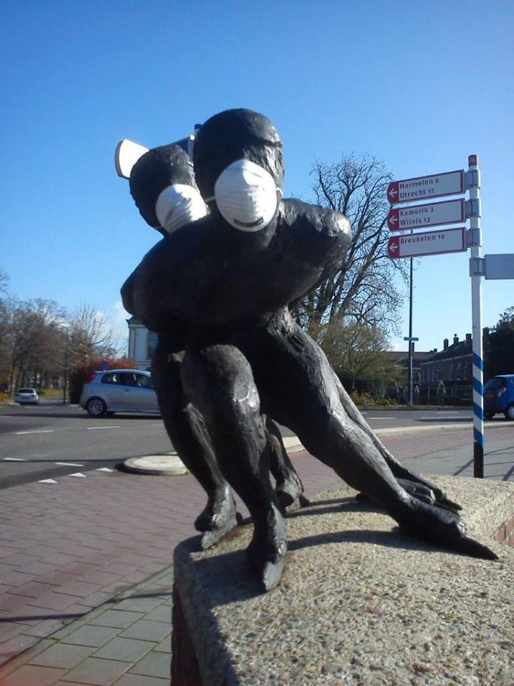

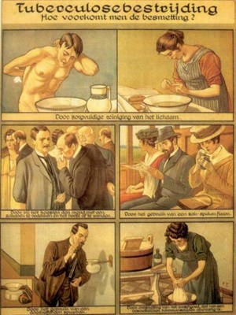

Welcome to Amsterdam

Slide 5
Program overview
08:15 – 09:25
Setting the stage towards the UN High-Level Meeting on TB
09:25 – 10:50
Preventive TB therapy for people living with HIV
How can the UN High-Level Meeting on TB accelerate the TB response?
10:50 – 11:20
Break & poster viewing
09:25 – 10:50
Unpacking TB/HIV mortality
13:00 – 14:15
Lunch & poster viewing
14:15 – 15:30
Driving the accountability framework from the top down and bottom up
TB/HIV in prisons
15:30 – 16:00
Break & poster viewing
16:00 – 17:45
Moving towards sustainable financing
17:45 – 19:00
Moving forward towards the UN High-Level Meeting on TB and beyond

Slide 6
Program overview
How can the UN High-Level Meeting on TB accelerate the TB response?
Setting the stage towards the UN High-Level Meeting on TB
How can the UN High-Level Meeting on TB accelerate the TB response?
Reflecting on the challenges to end TB and HIV
How do we achieve universal health coverage for TB and HIV?
Why is a multi-sectoral approach for TB important?
How can affected communities and civil society support a successful UN High-Level Meeting on TB?
How do we support countries to achieve their national plans through targeted interventions?

Slide 7
Program overview
How can the UN High-Level Meeting on TB accelerate the TB response?
Preventive TB therapy for people living with HIV
How do we bring TB prevention to scale?
WHO Consolidated guidelines for TB preventive treatment
Current IPT coverage and health system constraints
New avenues in TB preventive therapy
Community good practice
Role of civil society, role of HIV vs TB programs

Slide 8
Program overview
How can the UN High-Level Meeting on TB accelerate the TB response?
Unpacking TB/HIV mortality
Why have we failed to reduce TB/HIV mortality, what more can be done?
Where in the cascade of care does reducing mortality have its biggest impact and what are current barriers and lessons?
What works in scaling up TB-HIV treatment integration?
How do we address the MDR-TB/HIV coinfection epidemic?
Why is TB screening among PLWH not meeting targets?
Why are there not more HIV resources focused on TB?

Slide 9
Program overview
How can the UN High-Level Meeting on TB accelerate the TB response?
Driving the accountability framework from the top down and bottom up
How do we hold governments accountable?
How can community drive the agenda for the TB High-Level Meeting?
What should an accountability framework achieve?
How can we learn from other disease control programmes?
How can Ministers of Health obtain political support from other sectors of the government?
How do we monitor the accountability framework?

Slide 10
Program overview
How can the UN High-Level Meeting on TB accelerate the TB response?
TB/HIV in prisons
What is needed to fully address TB in closed settings?
What do we know about TB transmission biology?
How do we implement TB control in prisons with high TB burden?
What is best practice and what are the main challenges?
What does TB care in prisons really look like?

Slide 11
Program overview
How can the UN High-Level Meeting on TB accelerate the TB response?
Moving towards sustainable financing
How do we ensure financing the TB and HIV response in high-burden countries?
What is the magnitude of the funding gaps ?
What are the options for domestic financing, how do we use domestic resources more efficiently?
Are there alternative financing models?
Catastrophic costs of TB and HIV?

Slide 12
Program overview
How can the UN High-Level Meeting on TB accelerate the TB response?
Moving forward towards the UN High-Level Meeting
on TB and beyond
Call to action towards the UN High-Level Meeting on TB
The urgency of overcoming the bottlenecks to end TB and HIV
  Political
  Financial
  Access barriers
Country progress and challenges
The top five elements to consider at the UN High-Level Meeting on TB

Slide 13
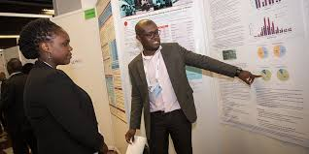
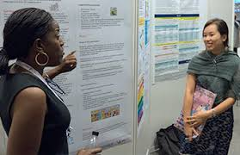
Program overview
Poster Viewing
10:50 – 11:20
13:00 – 14:15
15:30 – 16:00

Slide 14

Thanks to TB 2018 partners

Slide 15
Enjoy the meeting!

